Slide 1
ONCOLOGY : Strategic Dim3’s view
In Oncology, Interaction between Homecare and Hospital is high due to
- Frequency of hospital Diagnostic and follow-up visits
One day hospital treatment
Other cancer specific medical visits/treatment
Trends : Hospital@home / patient & family awareness
Nutritional care/therapy will be in first line in cancer care from Personalized Parenteral to Complements.

Slide 2
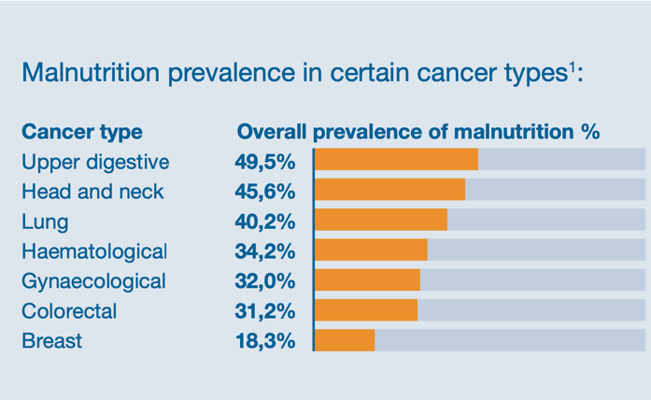
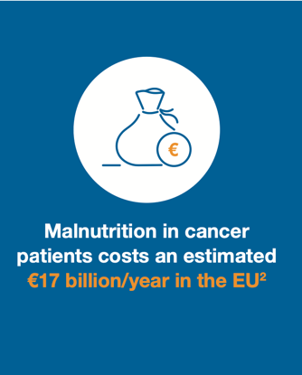
Malnutrition in cancer patients leads to poorer health outcomes, results in increased burden to healthcare resources.
1“Better care through better nutrition: value and effects of medical nutrition - A summary of the evidence base”
https://medicalnutritionindustry.com/files/user_upload/documents/medical_nutrition/2018_MNI_Dossier_Final_web.pdf
2“The economic costs of disease related malnutrition” Freijer, Karen et al. (Clinical Nutrition, Volume 32, Issue 1, 136 – 141)
https://www.clinicalnutritionjournal.com/article/S0261-5614(12)00132-X/fulltext
https://medicalnutritionindustry.com/files/user_upload/infographics/2020-01-30_MNI_Infographic_cancer.pdf

Slide 3
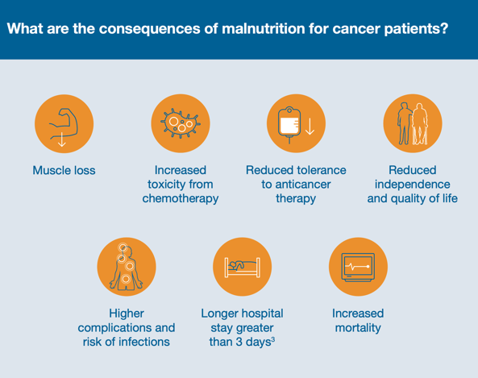
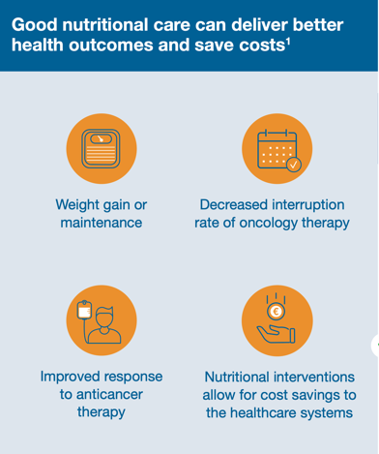
Malnutrition is Costly : ONCOLOGY
1“Better care through better nutrition: value and effects of medical nutrition - A summary of the evidence base”
https://medicalnutritionindustry.com/files/user_upload/documents/medical_nutrition/2018_MNI_Dossier_Final_web.pdf

Slide 4
DIM3 ONCOLOGY VISION
Individualized Support Across the Continuum
Oncological patients interacts frequently with hospital due to treatments , relapses and follow-up consultations. Data are often uncomplete/erroneous or not sharable
All cancer needs specific attention in Homecare especially Head&Neck, and Gastro-intestinal cancers requiring sometimes artificial nutrition
In Oncology, the patient and family itself understand that food is therapy
Any patient has specific nutrition needs due to personalized side effects of diseases and therapies (by example Aguzia, Anosmosia …)
Dim3’s platform can participate to personalized clinical food (as Nutritional Oral Complement) panel development using actionable collected data

Slide 5
ONCOLOGY
Individualized Support Across the Continuum by DIM3’s integrated Platform
PATIENT
& Others Actors
General Practitioner
Medical professionals
Family
HOMECARE / HOME
360° data collection
((Hospital/ GP/Assistance/ Patient/Family)
Push/Pull Actionable data circulation
Agendas/activities/
Logistic Management
Aggregation all Data of each Oncological patient
Personalized report on Clinical Nutrition
Therapy
Trough Medical reports , scoring/algorithms and evidence base development
Continuous Nutrition Recommendations and Folllow up
malnutrition criteria's triggering actions and alarms
HOSPITAL
Diagnostic
Surgery/
Treatments
Follow-up
Readmission

